Slide 1
PARKING MANAGEMENT
HOD: Mr M vinod Presented By:
Co-Ordinator: Mrs Sandhya Rani G.Sathwika(14321A1273)
Internal Guide: Mrs Navaneetha D CH.Vennela(14321A12B8)

Slide 2
Contents:
Objective
Existing System
Proposed System
Functional Requirements
System Architecture
Technical Architecture
Use Case Diagram
Activity Diagram
Class Diagram
Sequence Diagram
Database Design-ER Diagram

Slide 3
1. Objective
Variety of occasions turn up when we visit various public places like Shopping malls, 5-star and 7-star hotels, multiplex cinema halls, etc. The difficulty we encounter at these places is finding the availability of parking space. Most of the times we need to traverse through multiple parking slots to find a free space for parking.
The problem becomes more tedious if the parking’s are multi- stored. Thus the problem is time-consuming.
This situation calls for the need for an automated parking system that not only regulates parking in a given area but also keeps the manual intervention to a minimum.

Slide 4
2. Existing System
Existing parking system consist of many disadvantages. The system only provides the entrance to the parking area and will not provide the parking slot. The car owner searches the parking slot after entering to the parking area. It will take more time to find the slot.
The car owner have no idea about the parking area is fill or not. His responsibility is to find the parking slot and park his vehicle safely and safety for the vehicle is less.

Slide 5
3. Proposed System
when a car arrives at the entrance, it will be stopped at the main gate by the employee and provides a parking slip. This parking slip provides the full details about the vehicle. Like parking slot number, vehicle number, vehicle type, date, In-time.
This will help the driver for easy parking to the given available space. The employee knows about the parking status by using the web application and if the parking area is filled employee blocks the entrance.
The user can book his parking slot through android application.

Slide 6
4. Functional Requirements
Admin:
It will provide an authorized admin to add the employee details.
He can seasonally change the hourly based price for two-wheeler and four-wheeler.
He can view the report of vehicles.
Employee:
All the details of the user’s vehicle are added by the employee like vehicle details, date, time etc at the entrance.
Available locations are checked and the parking slot number is printed on the parking slip.
If a vehicle is out from the parking area. The employee uncheck the slot. So the slot is available for next vehicle

Slide 7
User:
User have to register and login into his/her account.
He books his slot by entering name, phone no, vehicle details.
He receives the payment slip and pays the bill to the employee.

Slide 8
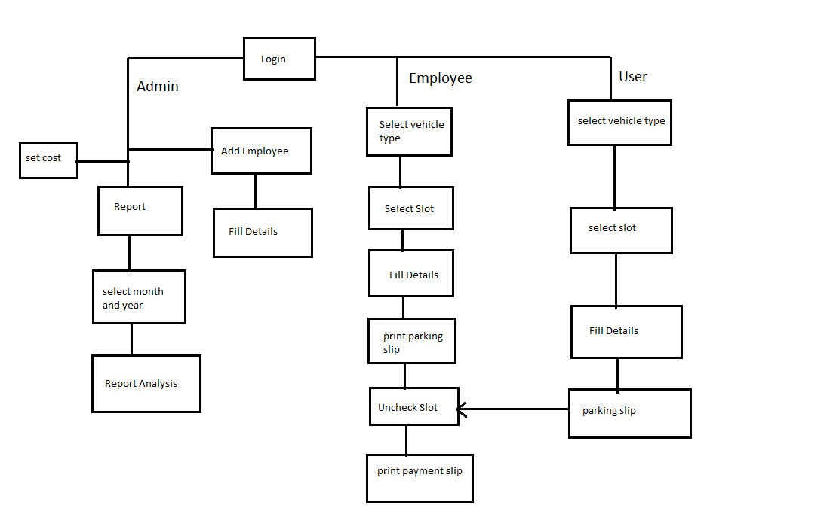
5. System Architecture

Slide 9
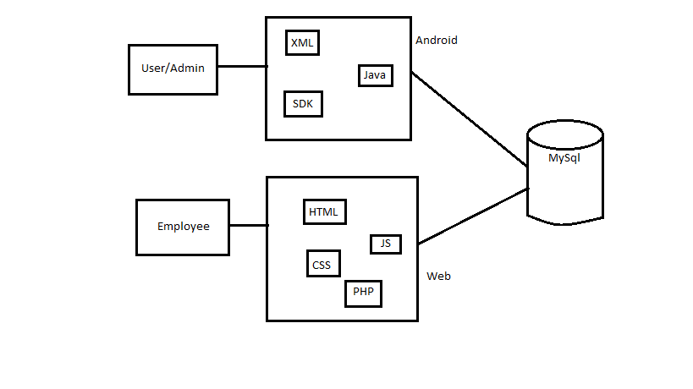
6. Technical Architecture

Slide 10
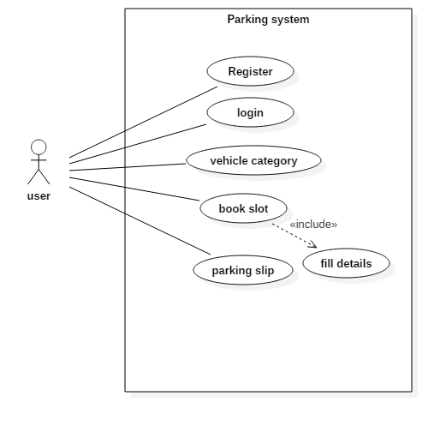
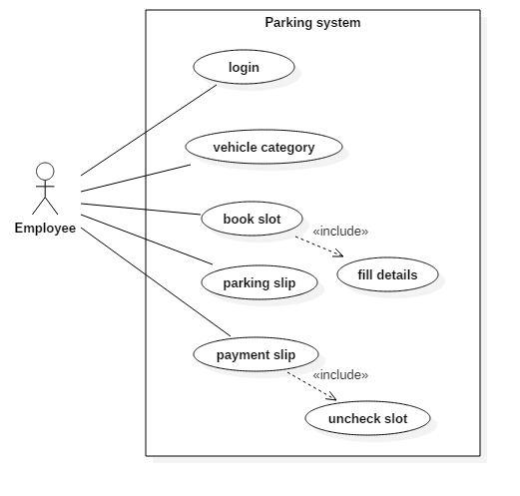
7. Use Case Diagram
user
employee

Slide 11
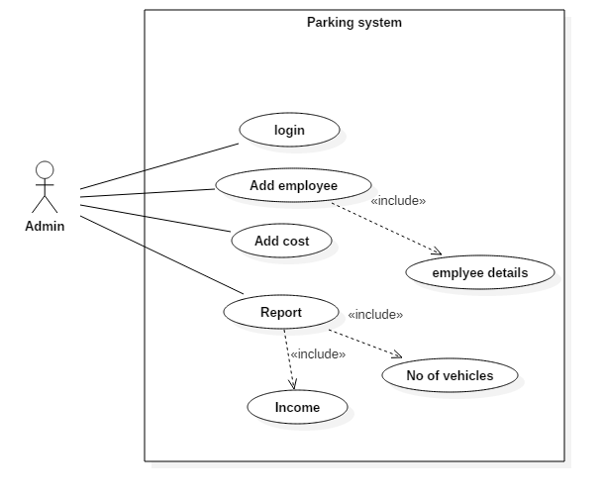
Admin

Slide 12
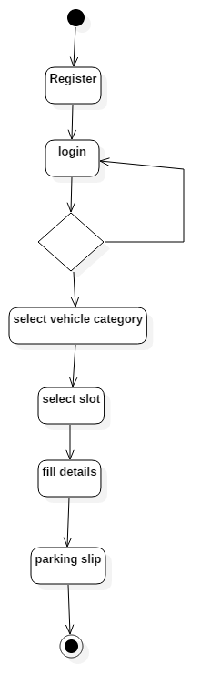
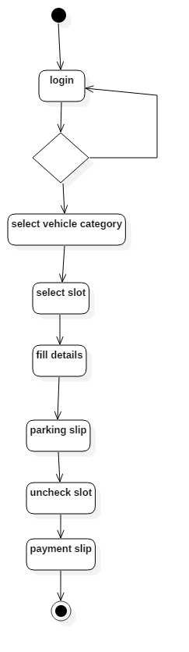
8. Activity Diagram
Employee
user

Slide 13
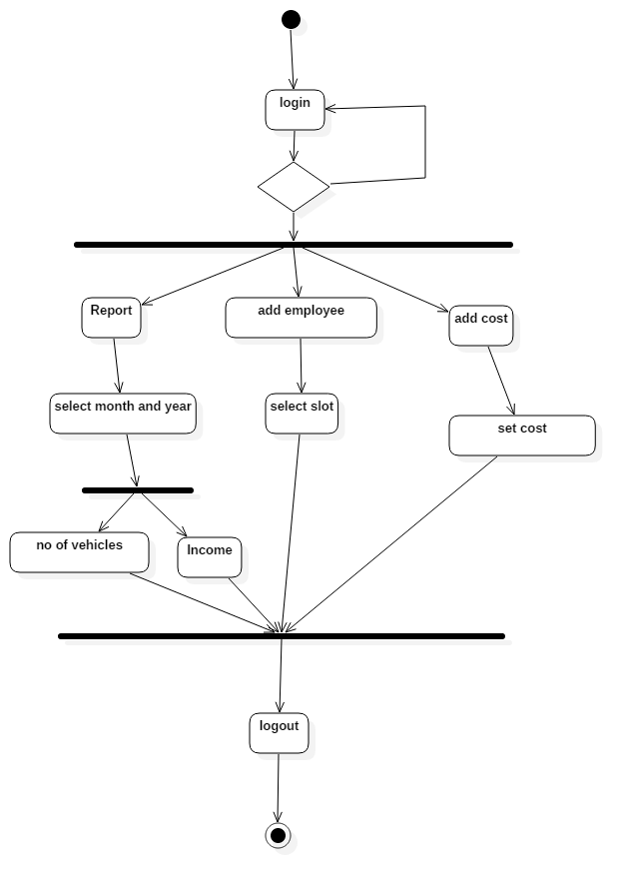
Admin

Slide 14
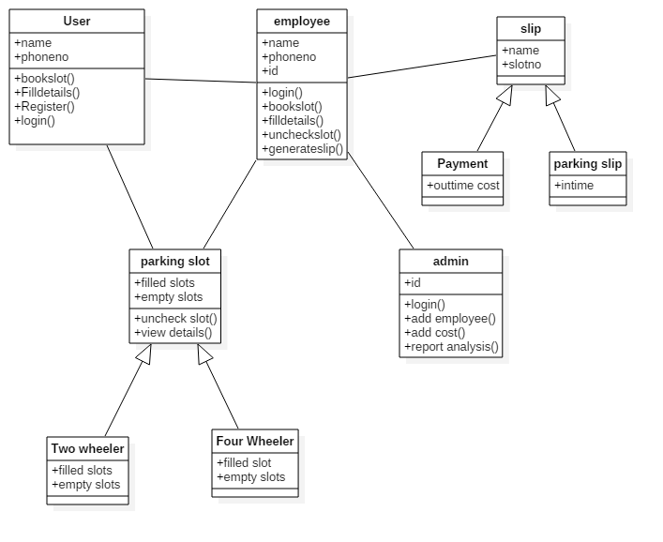
9. Class Diagram

Slide 15
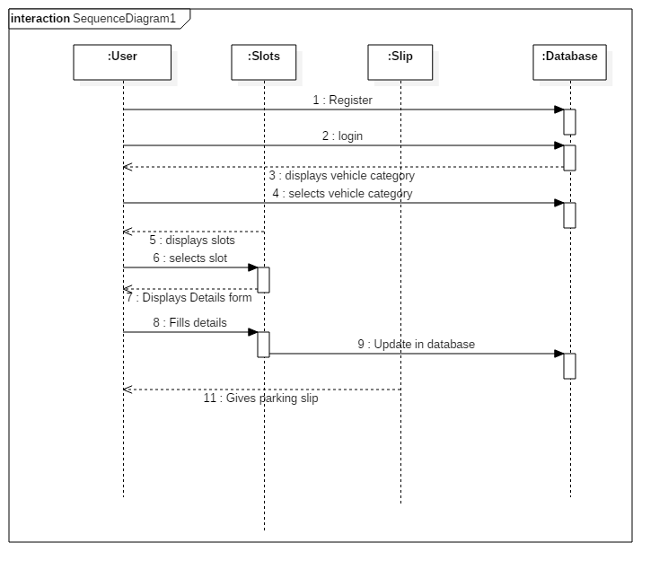
10. Sequence Diagram
user

Slide 16
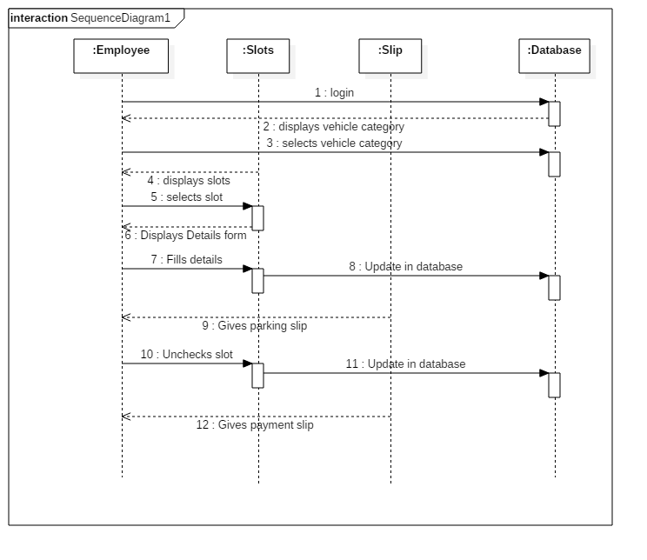
Employee

Slide 17
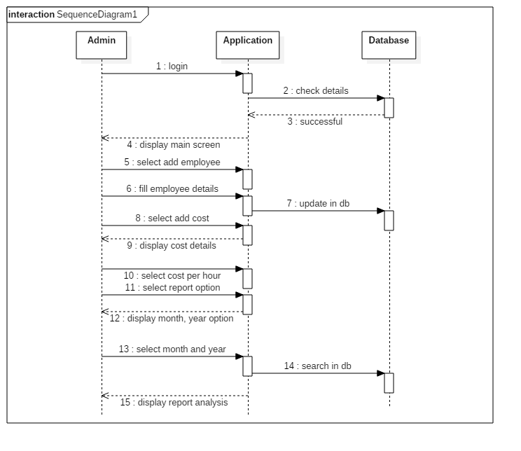
Admin

Slide 18
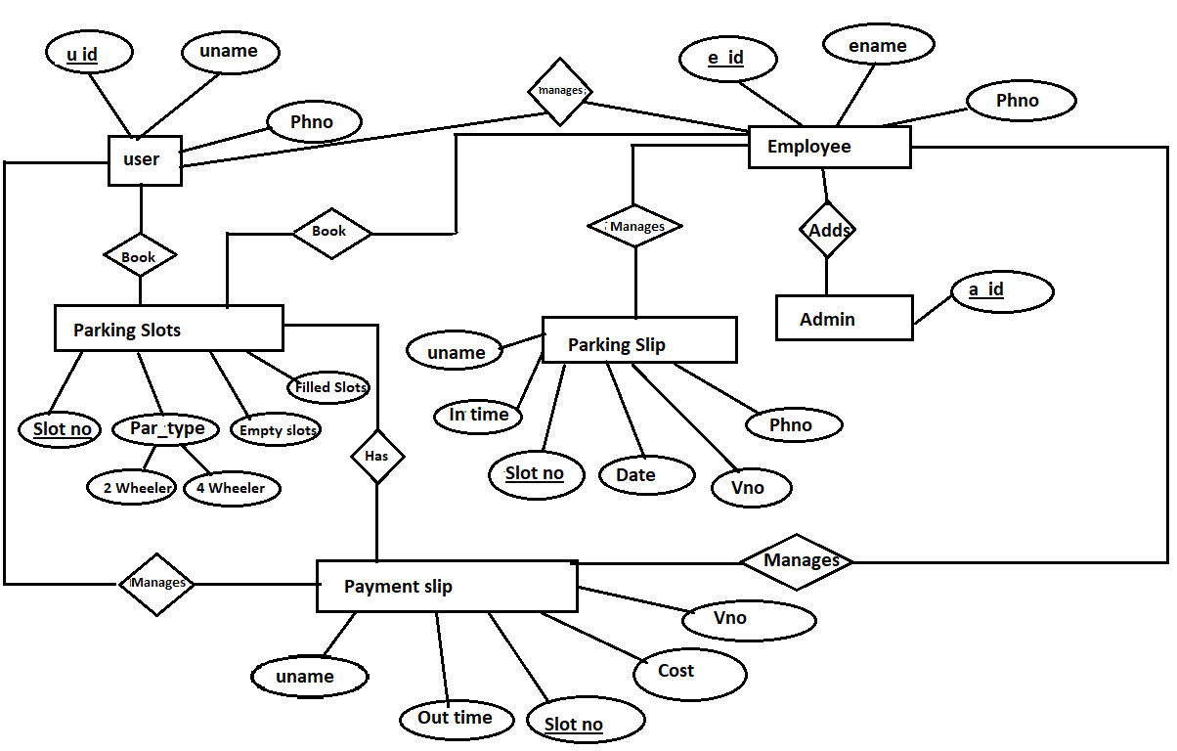
11. Database Design-ER Diagram

Slide 19


